Slide 1
INTRODUCTION TO DATA SCIENCE
Project 1
PHASE 1
TEAM 14

Slide 2



Team members
Alpha Team – In charge of data preprocessing and cleaning
Pham
Haven
Hussain
2299356
2308018
2338250
`

Slide 3

Team members
Bravo Team – In charge of SQL Workbench
Preetham
Jayanth
Srikavya
2288949
2288552
2311351
`

Slide 4
MetroPT-3 Dataset
From a metro train in an operational context, readings from pressure, temperature, motor current, and air intake valves were collected from a compressor's Air Production Unit (APU). This dataset reveals real predictive maintenance challenges encountered in the industry. It can be used for failure predictions, anomaly explanations, and other tasks.
# Instances: 1516948
# Features: 15
Dataset Characteristics: Tabular, Multivariate, Time-Series

Slide 5
Why we choose the dataset
This dataset was chosen because it contains information that was obtained from actual events that accurately reflect real-world situations. This makes it a valuable resource for developing and testing algorithms in the field of anomaly detection, failure prediction, and remaining useful life estimation. Additionally, the availability of failure reports from the company allows us to validate the performance of our algorithms against real-world incidents. Also, this dataset is also represent time series attribute, which is crucial for analyzing trends and patterns over a specific period. The inclusion of time series data enables researchers to observe the progression of anomalies and failures, providing deeper insights into their causes and potential mitigation strategies.

Slide 6
Goal and Methodology
Clean and label
Build a predictor to alert system failure
Remove unnecessary column
Format the timestamp column
Label data (Original dataset is not labelled)
Subsample to balance the dataset (Original dataset is highly imbalanced)
Find and drop all outliers
The system failure prediction problem is a binary classification
Using appropriate Machine Learning to build a predictor to predict system failure
Test the system on test set and validation
Apply various method such as F1 Score or ROC to select the best model

Slide 7
Phase 1 Accomplishment
Alpha team – Clean Data
Bravo team – SQL Workbech
Remove unnecessary column
Format the timestamp column
Label the data using maintenance table
Subsample to balance the dataset
Find and drop all outliers
Perform EDA on dataset and confirm no outliers left
Save data as csv and npz
Generate ipynb and pdf for report
Upload the clean dataset to mySQL Workbench
Export dataset as sql
Perform a query on mySQL Workbench
Perform Max() function on mySQL Workbench
Create a View and query that view on MySQL Workbench
Save function and command as SQL file
Writing Report and Cross-review

Slide 8
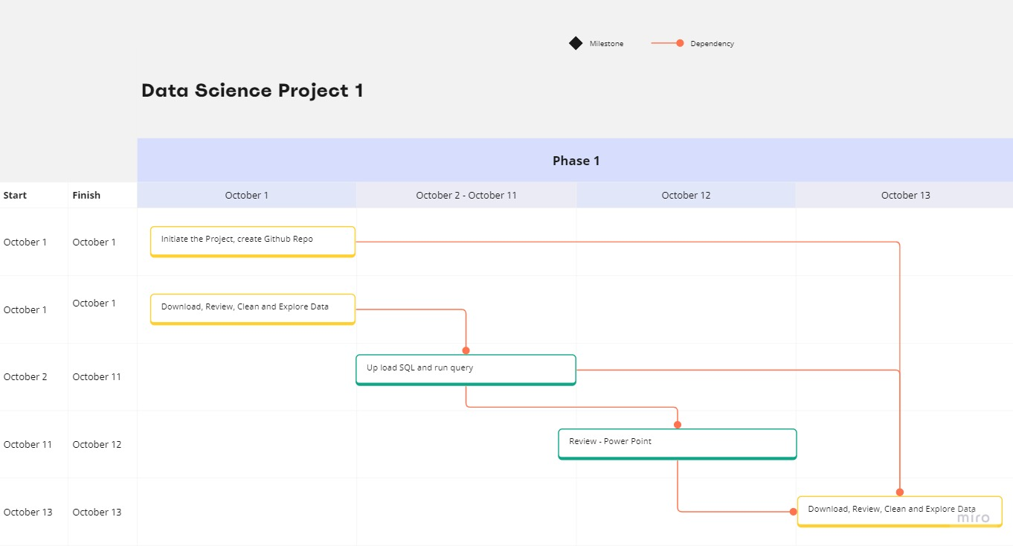
Progess Grantt Chart
Grantt chart for Phase 1 workflow

Slide 9
Thank you
Team 14

